Slide 1
Telescience WG
@PRAGMA 19

Slide 2
Presentations:
  7 Presentations
    E-Culture (Osaka Knowledge Capital City Exhibition; Nara 1300th Anniversary) (NICT)
    KLEON (KISTI)
    Serving CREON data in OGC-SWE complaint manner (UCSD)
    Urban Monitoring (KonKuk U)
    Simulation of Coastal Changes in Thailand (NECTEC)
    Environment Informatorium: The Sustainable Web Portal for Observation Data (NECTEC)
    Development of Estimated Surface Air Temperature (ESAT) map based on OGC Web Services (Hyogo Univ)
    GLEON/CREON (NCHC)
    Tiger Watch (Kasetsart U.) (in planning stage)

Slide 3
Strength & Weakness
Strength:
  Observation
  Data Management
  Visualization
Weakness
  Simulation (Analysis/workflows)
  Data use

Slide 4
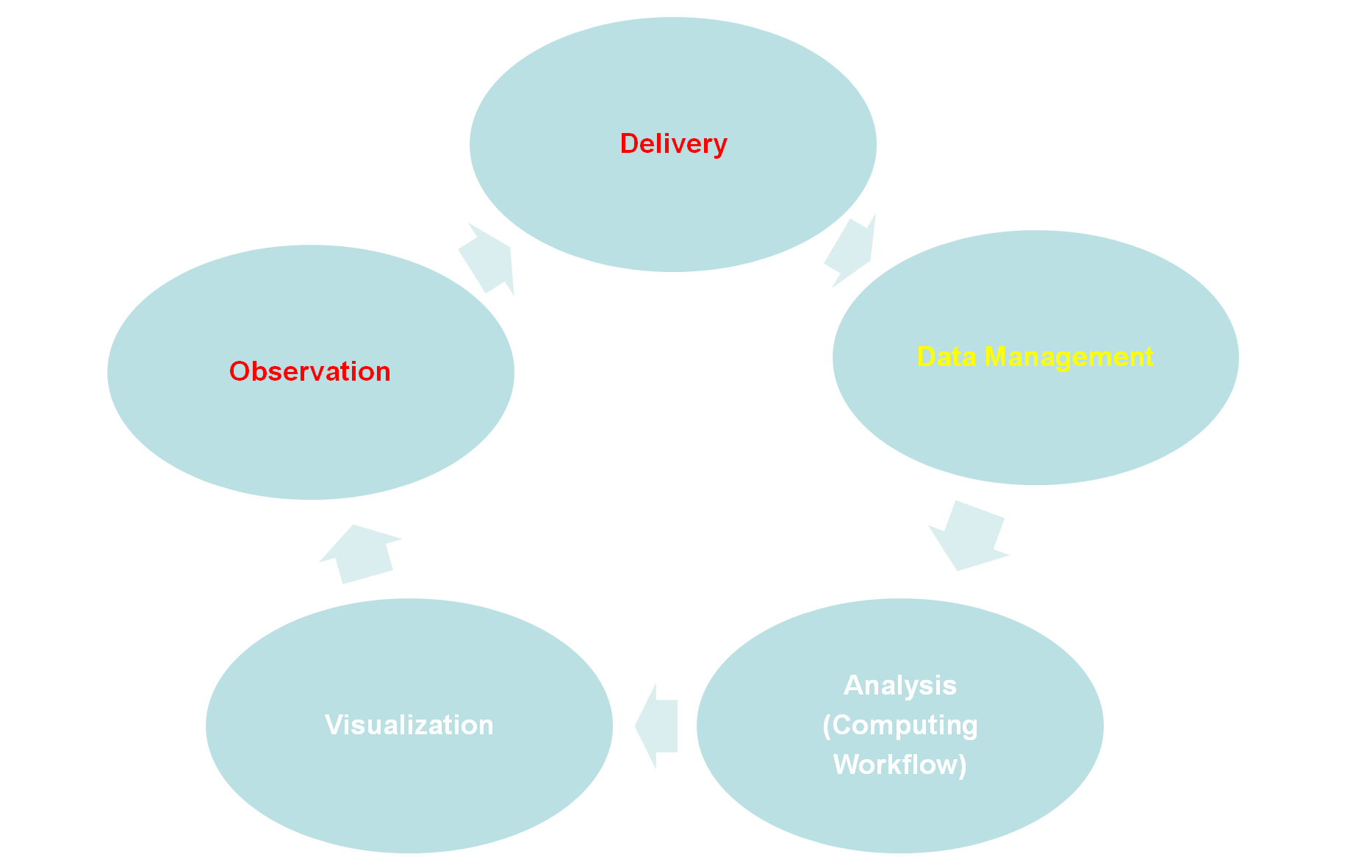
Source: Karpjoo

Slide 5
Work together
New Model: Institutes to Institute vs Community to Community
  PRAGMA (Tele/Geo-Sci) vs GLEON/CREON
Technological Integration:
  Common Software Stack: Rocks, Dataturbine, OGC,POSTGRES … etc.
  Adopting standards: OGC-based standard.
  Shared Architecture: to be done later via WG website.
  Joint proposal to boost short term (6 months) development. Telescience CI for CREON (and/or GLEON) (provisional)

Slide 6
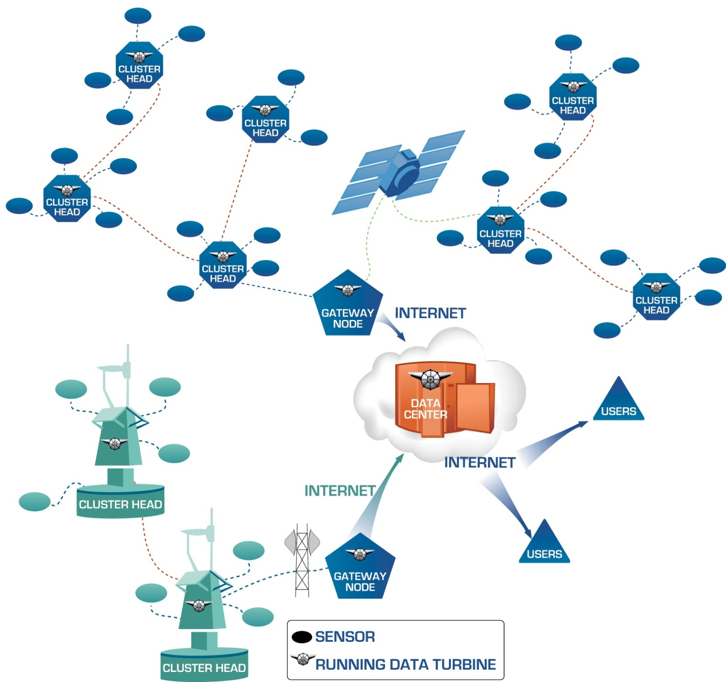
Generic Observing System Architecture
Focus: Move computation into the field with Embedded Cyberinfrastructure
Sensors
Cluster Head: aggregation point for sensors. Last IP-addressable point in network
Gateway Node: entry point to the Internet
Source: sameer
A generic architecture facilitates scalability, robustness, reproducibility, and efficiency.

Slide 7
WSN Virtual Organization
WSN
WSN VO
Virtual
Organization
For WSNs
WSN
Admin
Environment
WSN
WSN
WSN
WSN
Management
WSN
WSN
WSN
Application
WSN
Source: Karpjoo

